Slide 1
Factory Automation and Control Methods
Lecture 10: Storage Systems
Daro VAN
Paragon International University
Faculty of Engineering
Department of Industrial Engineering

Slide 2
Outline
Introduction to Storage Systems
Conventional Storage Methods and Equipment
Automated Storage Systems
Analysis of Storage Systems

Slide 3
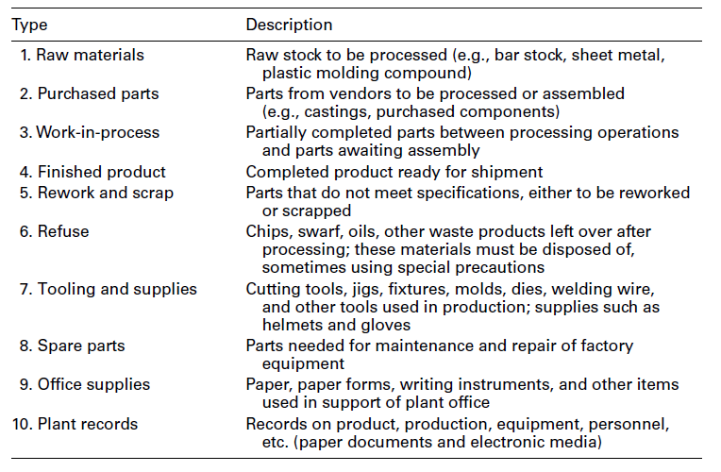
Intro to Storage Systems

Slide 4
Intro to Storage Systems
Various measures used to assess the performance of a storage system include:
storage capacity,
(2) storage density,
(3) accessibility, and
(4) throughput. In addition, standard measures used for mechanized and automated systems include
(5) utilization and
(6) reliability

Slide 5
Intro to Storage Systems
Storage capacity can be defined and measured in two ways:
as the total volumetric space available or
(2) as the total number of storage compartments in the system available to hold items or loads.
Storage density is defined as the volumetric space available for actual storage relative to the total volumetric space in the storage facility.
Accessibility refers to the capability to access any desired item or load stored in the system. In the design of a given storage system, appropriate trade-offs must be made between storage density and accessibility

Slide 6
Intro to Storage Systems
System throughput is defined as the hourly rate at which the storage system
receives and puts loads into storage and/or
retrieves and delivers loads to the output station.
Utilization is defined as the proportion of time that the system is actually being used for performing operations compared with
the time it is available.
Availability is a measure of system reliability, defined as the proportion of time that the system is capable of operating (not broken down) compared with the normally scheduled
shift hours

Slide 7
Intro to Storage Systems
Storage Location Strategies
The two basic strategies applied in warehousing operations are
randomized storage: items are stored in any available location in the storage system.
dedicated storage. SKUs are assigned to specific locations in the storage facility.
Note : Each item type stored in a warehouse is known as a stock-keeping-unit (SKU).

Slide 8
Intro to Storage Systems
Storage Location Strategies
The basis for specifying the storage locations is usually one of the following:
items are stored in part number or product number sequence;
items are stored according to activity level, the more active SKUs being located closer to the input/output station; or
items are stored according to their activity-to-space ratios, the higher ratios being located closer to the input/output station.

Slide 9
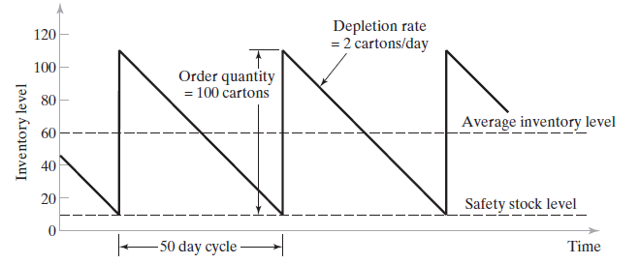
Intro to Storage Systems
Storage Location Strategies
Comparison of Storage Strategies
Suppose that a total of 50 SKUs must be stored in a storage system. For each SKU, average order quantity = 100 cartons, average depletion rate = 2 cartons /day, and safety stock level = 10 cartons. Each carton requires one storage location in the system. Based on this data, each SKU has an inventory cycle that lasts 50 days. Since there are 50 SKUs in all, management has scheduled incoming orders so that a different SKU arrives each day. Determine the number of storage locations required in the system under two alternative strategies:
randomized storage and
(b) dedicated storage.

Slide 10
Intro to Storage Systems
Storage Location Strategies
Comparison of Storage Strategies
The maximum inventory level, which occurs just after an order has been received, is the sum of the order quantity and safety stock level:
Maximum inventory level = 100 + 10 = 110 cartons
The average inventory is the average of the maximum and minimum inventory levels under the assumption of uniform depletion rate. The minimum value occurs just before an order is received when the inventory is depleted to the safety stock level:
Minimum inventory level = 10 cartons
Average inventory level = (110 + 10) / 2 = 60 cartons

Slide 11
Intro to Storage Systems
Storage Location Strategies
Comparison of Storage Strategies
(a) Under a randomized storage strategy, the number of locations required for each SKU is equal to the average inventory level of the item, since incoming orders are scheduled each day throughout the 50-day cycle. This means that when the inventory level of one SKU near the beginning of its cycle is high, the level for another SKU near the end of its cycle is low. Thus, the number of storage locations required in the system = (50 SKUs) (60 cartons) = 3,000 locations.
(b) Under a dedicated storage strategy, the number of locations required for each SKU must equal its maximum inventory level. Thus, the number of storage locations required in the storage system =50 SKUs(110 cartons) = 5,500 locations.

Slide 12
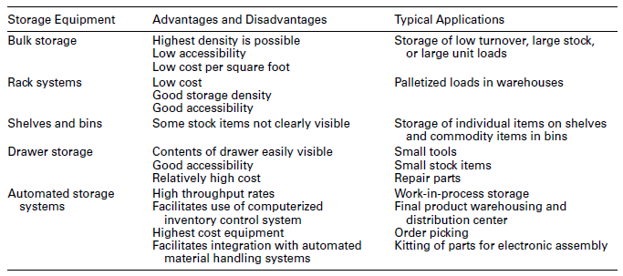
Conventional Storage Methods and Equipment

Slide 13
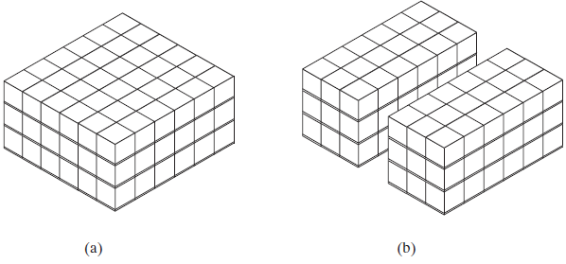
Conventional Storage Methods and Equipment
Bulk Storage
Two bulk storage arrangements: (a) high-density bulk storage provides low accessibility; (b) bulk storage with loads arranged to form rows and blocks for improved accessibility.

Slide 14
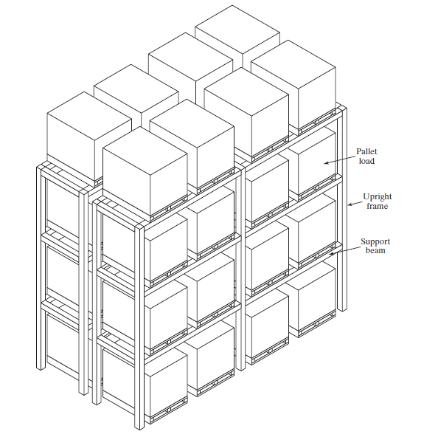
Conventional Storage Methods and Equipment
Rack Systems
Pallet rack system for storage of unit loads on pallets.

Slide 15
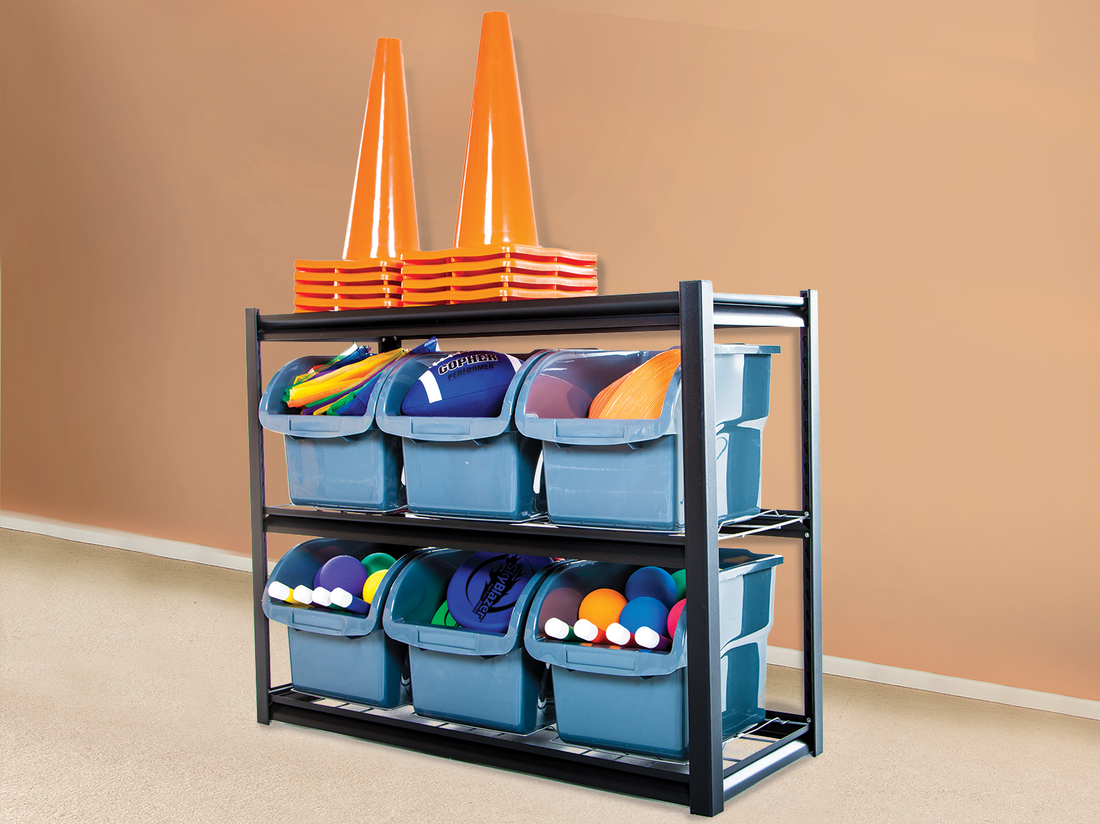
Conventional Storage Methods and Equipment
Shelving and Bins

Slide 16
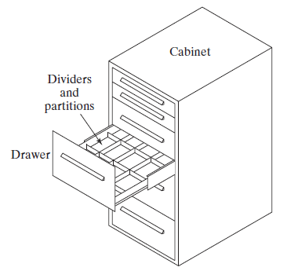
Conventional Storage Methods and Equipment
Drawer Storages
Drawer storage.

Slide 17
Automated Storage Systems
In highly automated systems, loads are entered or retrieved under computer control, with no human participation except to input data to the computer.
Advantage and Disadvantage | Typical Applications
High throughput rates | Work-in-process storage
Facilitates use of computerized inventory control system | Final product warehousing and distribution center
Highest cost equipment | Order picking
Facilitates integration with automated material handling systems | Kitting of parts for electronic assembly

Slide 18
Automated Storage Systems
Possible Objectives and Reasons for Automating a Company’s storage Operation
To increase storage capacity
To increase storage density
To recover factory floor space presently used for storing work-in-process
To improve security and reduce pilferage
To improve safety in the storage function
To reduce labor cost and/or increase labor productivity in storage operations
To improve control over inventories
To improve stock rotation
To improve customer service
To increase throughput

Slide 19
Automated Storage Systems
Automated storage systems divide into two general types:
fixed-aisle automated storage/retrieval systems. A fixed-aisle AS/RS consists of:
Rack structure for storing loads
A storage/retrieval machine whose motions are linear
(2) carousel storage systems: use storage baskets attached to a chain-driven conveyor that revolves around an oval track
loop to deliver the baskets to a load/unload station.

Slide 20
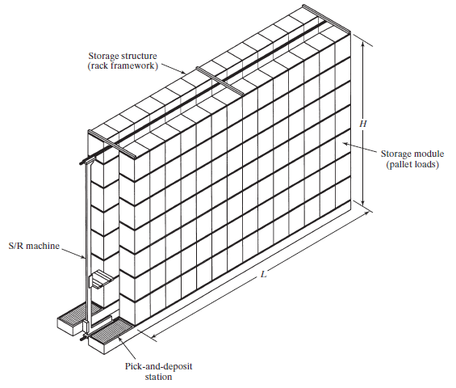
Automated Storage Systems
(540) AS/RS Automated Storage and Retrieval Systems- Warehousing Technology - YouTube
One aisle of a unit load automated storage/retrieval
system (AS/RS).

Slide 21
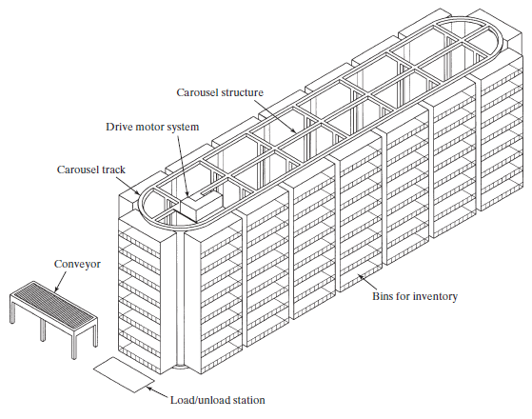
Automated Storage Systems
A horizontal storage carousel
(540) VIDEO 5.16 Horizontal Carousel by Kardex Remstar - YouTube

Slide 22
Automated Storage Systems
Feature | Fixed-Aisle AS/RS | Carousel Storage Systems
Storage structure | Rack system to support pallets or shelf system to support tote bins | Baskets suspended from overhead conveyor trolleys
Motions | Linear motions of S/R machine | Revolution of conveyor trolleys around oval track
Storage/retrieval operation | S/R machine travels to compartments in rack structure | Conveyor revolves to bring baskets to load/unload station
Replication of storage capacity | Multiple aisles, each consisting of rack structure and S/R machine | Multiple carousels, each consisting of oval track and storage bins

Slide 23
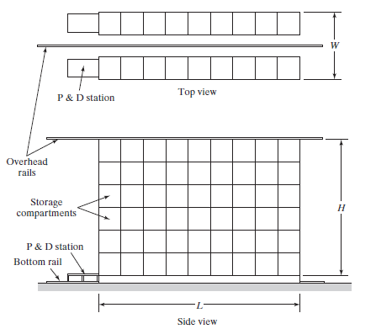
Automated Storage Systems
Fixed-Aisle Automated Storage/Retrieval Systems
Top and side views of a unit load AS/RS, with nine storage compartments
horizontally ($n_{y}$ = 9) and six compartments vertically ($n_{z}$ = 6).

Slide 24
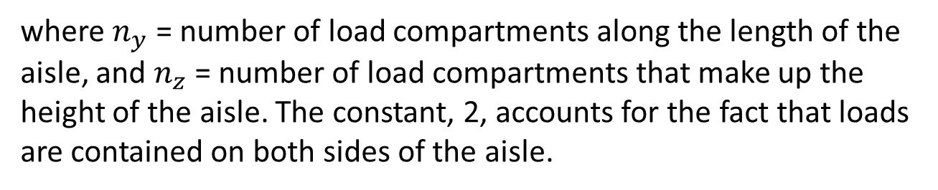

Analysis of Storage Systems
Fixed-Aisle Automated Storage/Retrieval Systems
Sizing the AS/RS Rack Structure.
The total storage capacity of one storage aisle depends on how many storage compartments are arranged horizontally and vertically in the aisle This can be expressed as
Capacity per aisle $=2n_{y}n_{z}$
where $n_{y}$ = number of load compartments along the length of the aisle, and $n_{z}$ = number of load compartments that make up the height of the aisle. The constant, 2, accounts for the fact that loads are contained on both sides of the aisle.

Slide 25
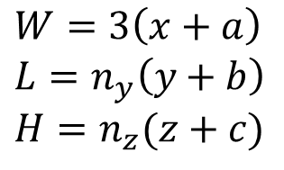
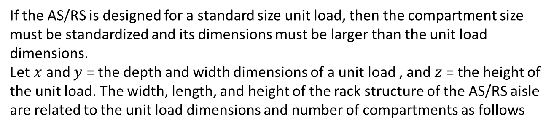
Analysis of Storage Systems
Fixed-Aisle Automated Storage/Retrieval Systems
If the AS/RS is designed for a standard size unit load, then the compartment size must be standardized and its dimensions must be larger than the unit load dimensions.
Let $x$ and $y$ = the depth and width dimensions of a unit load , and $z$ = the height of the unit load. The width, length, and height of the rack structure of the AS/RS aisle are related to the unit load dimensions and number of compartments as follows
$$W=3\left(x+a\right) \\ L=n_{y}\left(y+b\right) \\ H=n_{z}(z+c)$$
where W, L , and H are the width, length, and height of one aisle of the AS/RS rack structure, mm ; x, y, and z are the dimensions of the unit load, mm; and a, b, and c are allowances designed into each storage compartment to provide clearance for the unit load and to account for the size of the supporting beams in the rack structure, mm.

Slide 26
Analysis of Storage Systems
Fixed-Aisle Automated Storage/Retrieval Systems
EXAMPLE 11.2 Sizing an AS/RS System
Each aisle of a four-aisle AS/RS contains 60 storage compartments in the length direction and 12 compartments vertically. All storage compartments are the same size to accommodate standard-size pallets of dimensions: x = 42 in and y = 48 in. The height of a unit load z = 36 in. Using the allowances a = 6 in, b = 8 in, and c = 10 in, determine (a) how many unit loads can be stored in the AS/RS and (b) the width, length, and height of the AS/RS.

Slide 27
Analysis of Storage Systems
Fixed-Aisle Automated Storage/Retrieval Systems
Solution:
Capacity per aisle = 2(60)(12) = 1,440 unit loads. With four aisles,
the total capacity is AS / RS capacity = 4(1440) = 5,760 unit loads
(b) the dimensions of the storage rack structure can be computed as:
W = 3(42 + 6) = 144 in = 12 ft /aisle
Overall width of the AS / RS = 4(12) = 48 ft
L = 60(48 + 8) = 3,360 in = 280 ft
H = 12(36 + 10) = 552 in = 46 ft

Slide 28
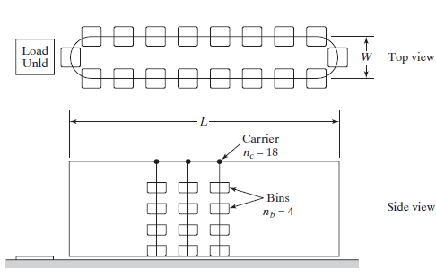

Analysis of Storage Systems
Carousel Storage System
Storage Capacity
Top and side views of horizontal storage carousel with 18 carriers
($n_{c}$ = 18) and four bins/carrier ($n_{b}$= 4). Key: Unld = unload.

Slide 29
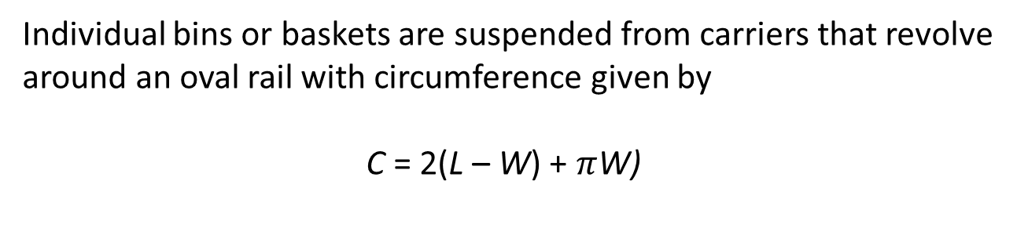
Analysis of Storage Systems
Carousel Storage System
Storage Capacity
Individual bins or baskets are suspended from carriers that revolve
around an oval rail with circumference given by
C = 2(L – W) + $π$W)
where C = circumference of the oval conveyor track, m (ft); and L and W are the length and width of the track oval, m (ft).

Slide 30

Analysis of Storage Systems
Carousel Storage System
Storage Capacity
The capacity of the carousel system depends on the number and size of the bins (or baskets) in the system. Assuming standard-size bins are used, each of a certain volumetric capacity, the number of bins can be used as the measure of capacity. Thus,
$$Total number of bin=n_{c}n_{b}$$

Slide 31

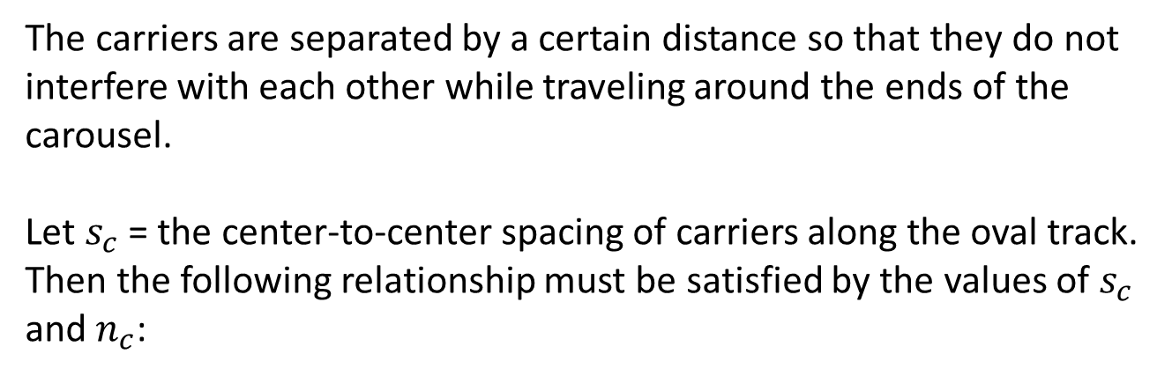
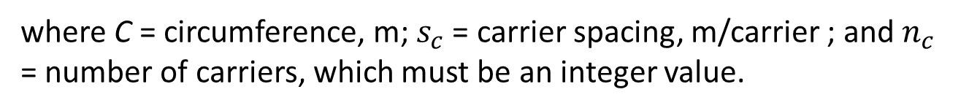
Analysis of Storage Systems
Carousel Storage System
Storage Capacity
The carriers are separated by a certain distance so that they do not interfere with each other while traveling around the ends of the carousel.
Let $s_{c}$ = the center-to-center spacing of carriers along the oval track. Then the following relationship must be satisfied by the values of $s_{c}$ and $n_{c}$:
$$s_{c}n_{c}=C$$
where C = circumference, m; $s_{c}$ = carrier spacing, m/carrier ; and $n_{c}$ = number of carriers, which must be an integer value.

Slide 32
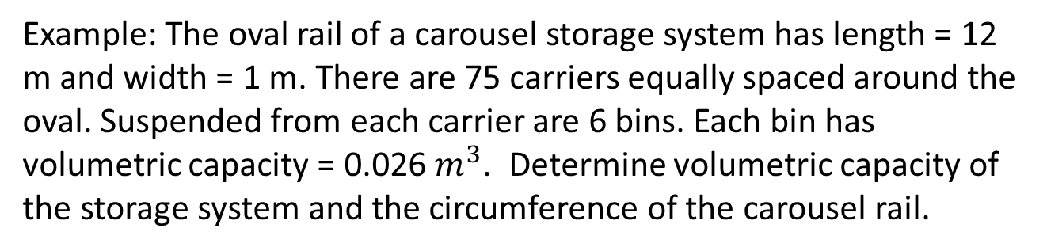
Analysis of Storage Systems
Carousel Storage System
Storage Capacity
Example: The oval rail of a carousel storage system has length = 12 m and width = 1 m. There are 75 carriers equally spaced around the oval. Suspended from each carrier are 6 bins. Each bin has volumetric capacity = 0.026 $m^{3}$. Determine volumetric capacity of the storage system and the circumference of the carousel rail.

Slide 33

Analysis of Storage Systems
Carousel Storage System
Storage Capacity
Total number of bins in the carousel is
$$n_{c}n_{b}=75 ×6=450bin$$
Total volumetric capacity = $450 \left(0.026\right)=11.7m^{3}$
The circumference of the carousel rail is
$$C=2\left(12−1\right)+1π=25.14m$$

Slide 34
References
Mikell P. Groover, “Automation, Production Systems and Computer-integrated Manufacturing” , 4th edition, Pearson, chapter 12

